Slide 1


Timber Mountain: CTA Copy Test Results
A data-driven analysis of how our CTA language impacts mobile user engagement
October 2024
by Andre Rand

Slide 2

The Mobile Engagement Challenge
Our Mobile Reality
While 63% of Timber Mountain sessions occur on mobile devices, our mobile detail-page click-through rate (CTR) lags significantly behind desktop performance by 27%.
This engagement gap represents a critical opportunity to improve the customer journey on our most-used platform.
Mobile users face navigation challenges that desktop users don't experience, particularly with CTA visibility and interaction.

Slide 3
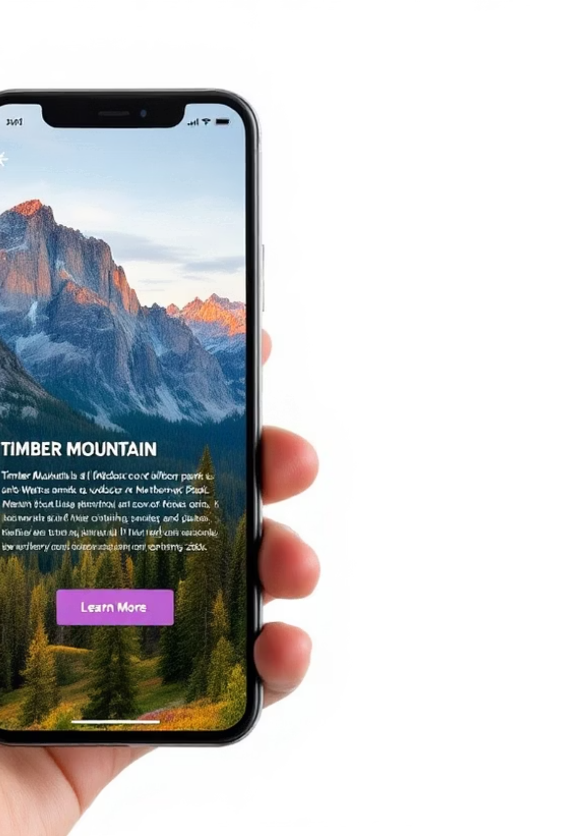
Current User Experience Analysis
Visual Hierarchy Issues
Heuristic review revealed CTAs pushed low in the visual hierarchy, making them less noticeable to mobile users scanning content quickly.
Competing Elements
Primary buttons compete with highly tappable hero images, creating confusion about the primary navigation path.
Stakeholder Insight
Team hypothesis: more action-oriented CTA copy might stimulate exploration without requiring significant engineering resources or design overhauls.

Slide 4
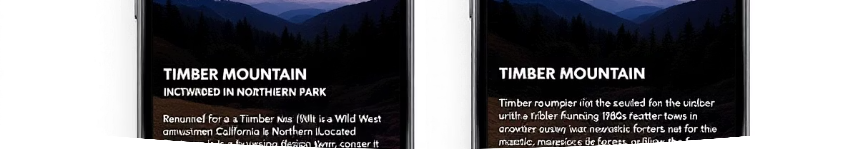
Our Test Hypothesis
Swapping default button copy from "Learn More" to the more action-oriented "Explore More" will raise site-wide detail-page CTR by ≥ 3% on mobile devices.
The hypothesis stemmed from behavioral psychology research suggesting that verbs emphasizing discovery ("explore") might trigger stronger curiosity than passive learning prompts.

Slide 5
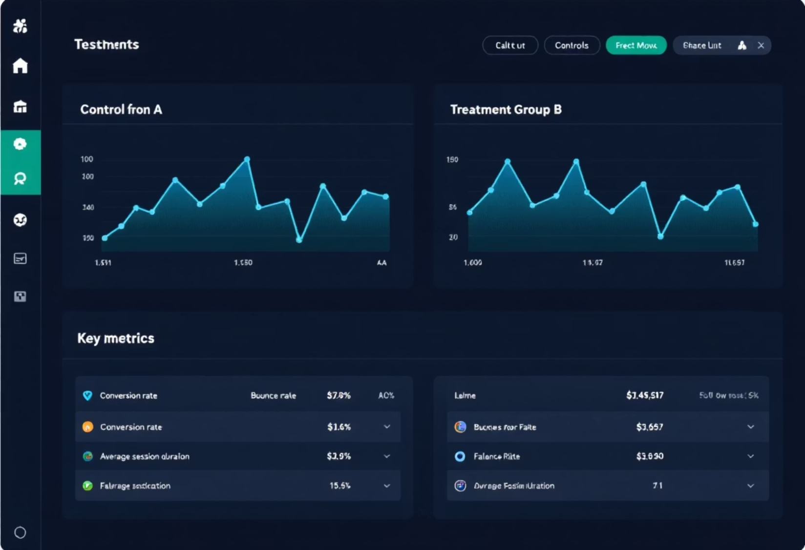
Test Implementation Details
Test Parameters
Geo
Global deployment
Audience
Mobile visitors (UA width < 768px)
Duration
Oct 7 - Oct 21, 2024 (14 days)
Split
50/50 randomization at session start
Primary KPI
Detail-page CTR (taps ÷ impressions)
Statistical Test
Two-tailed z-test, α = 0.05
The test was designed with sufficient power (95%) to detect a minimum 3% lift in our primary KPI, while monitoring key guardrail metrics to ensure no negative impact on user experience.

Slide 6
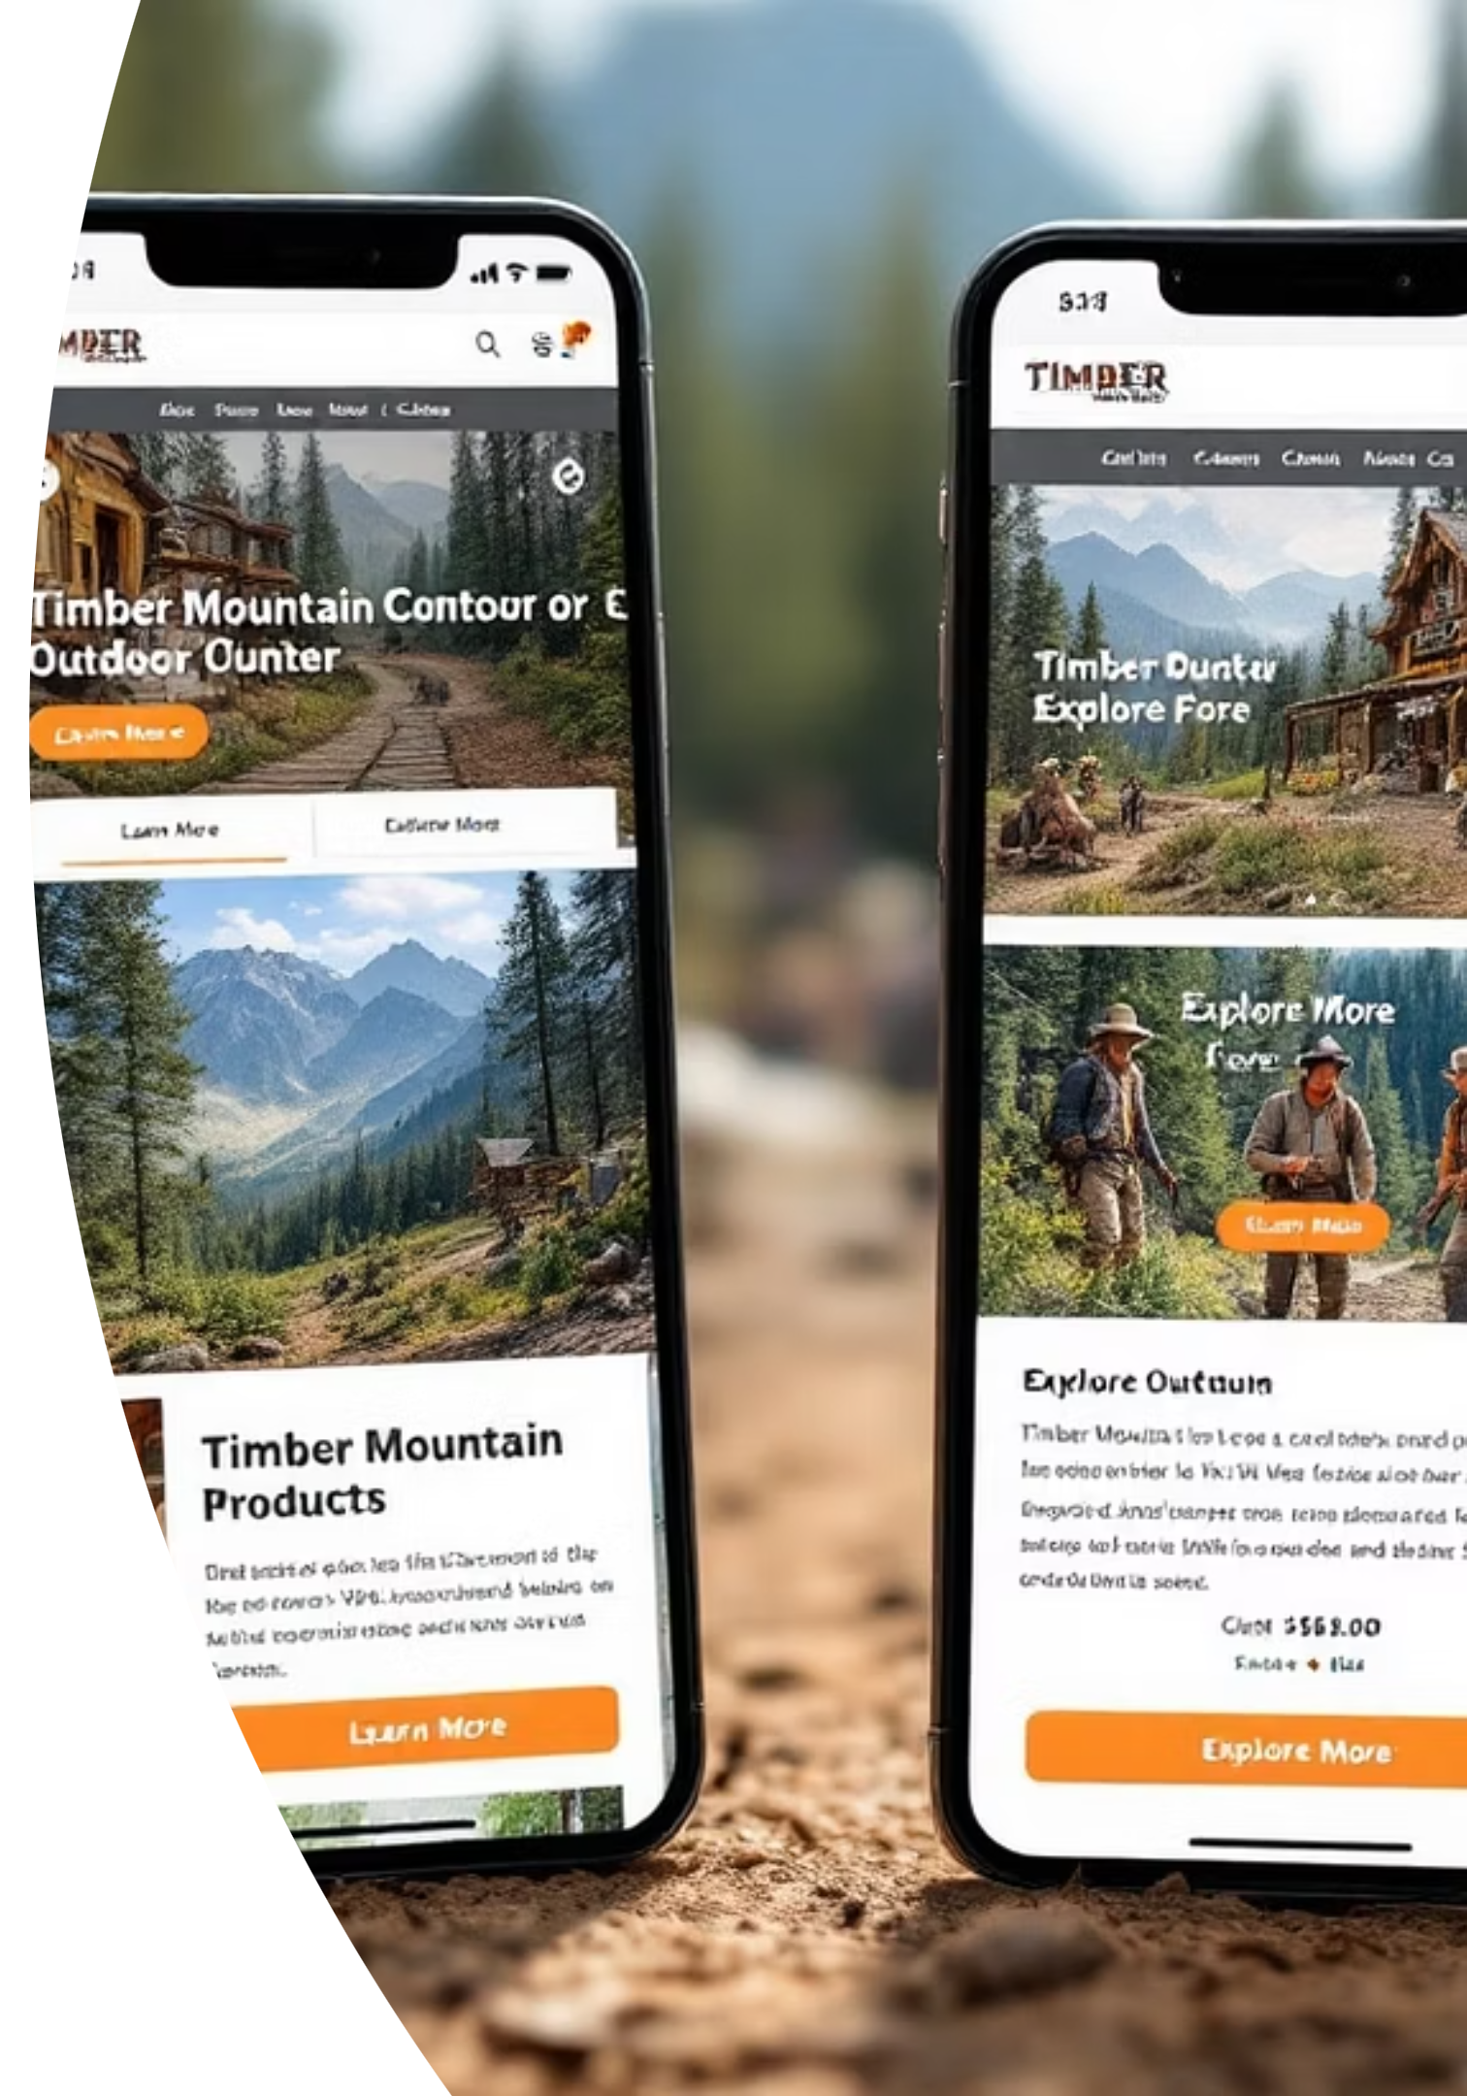
Comparing Control vs. Treatment
Both variants maintained identical visual styling, placement, and interaction behavior. The only difference was the button copy itself - ensuring we isolated this single variable for testing.
Control: "Learn More" - our standard CTA language across the site
Treatment: "Explore More" - more action-oriented alternative with identical styling
No other design elements were modified to maintain test integrity

Slide 7
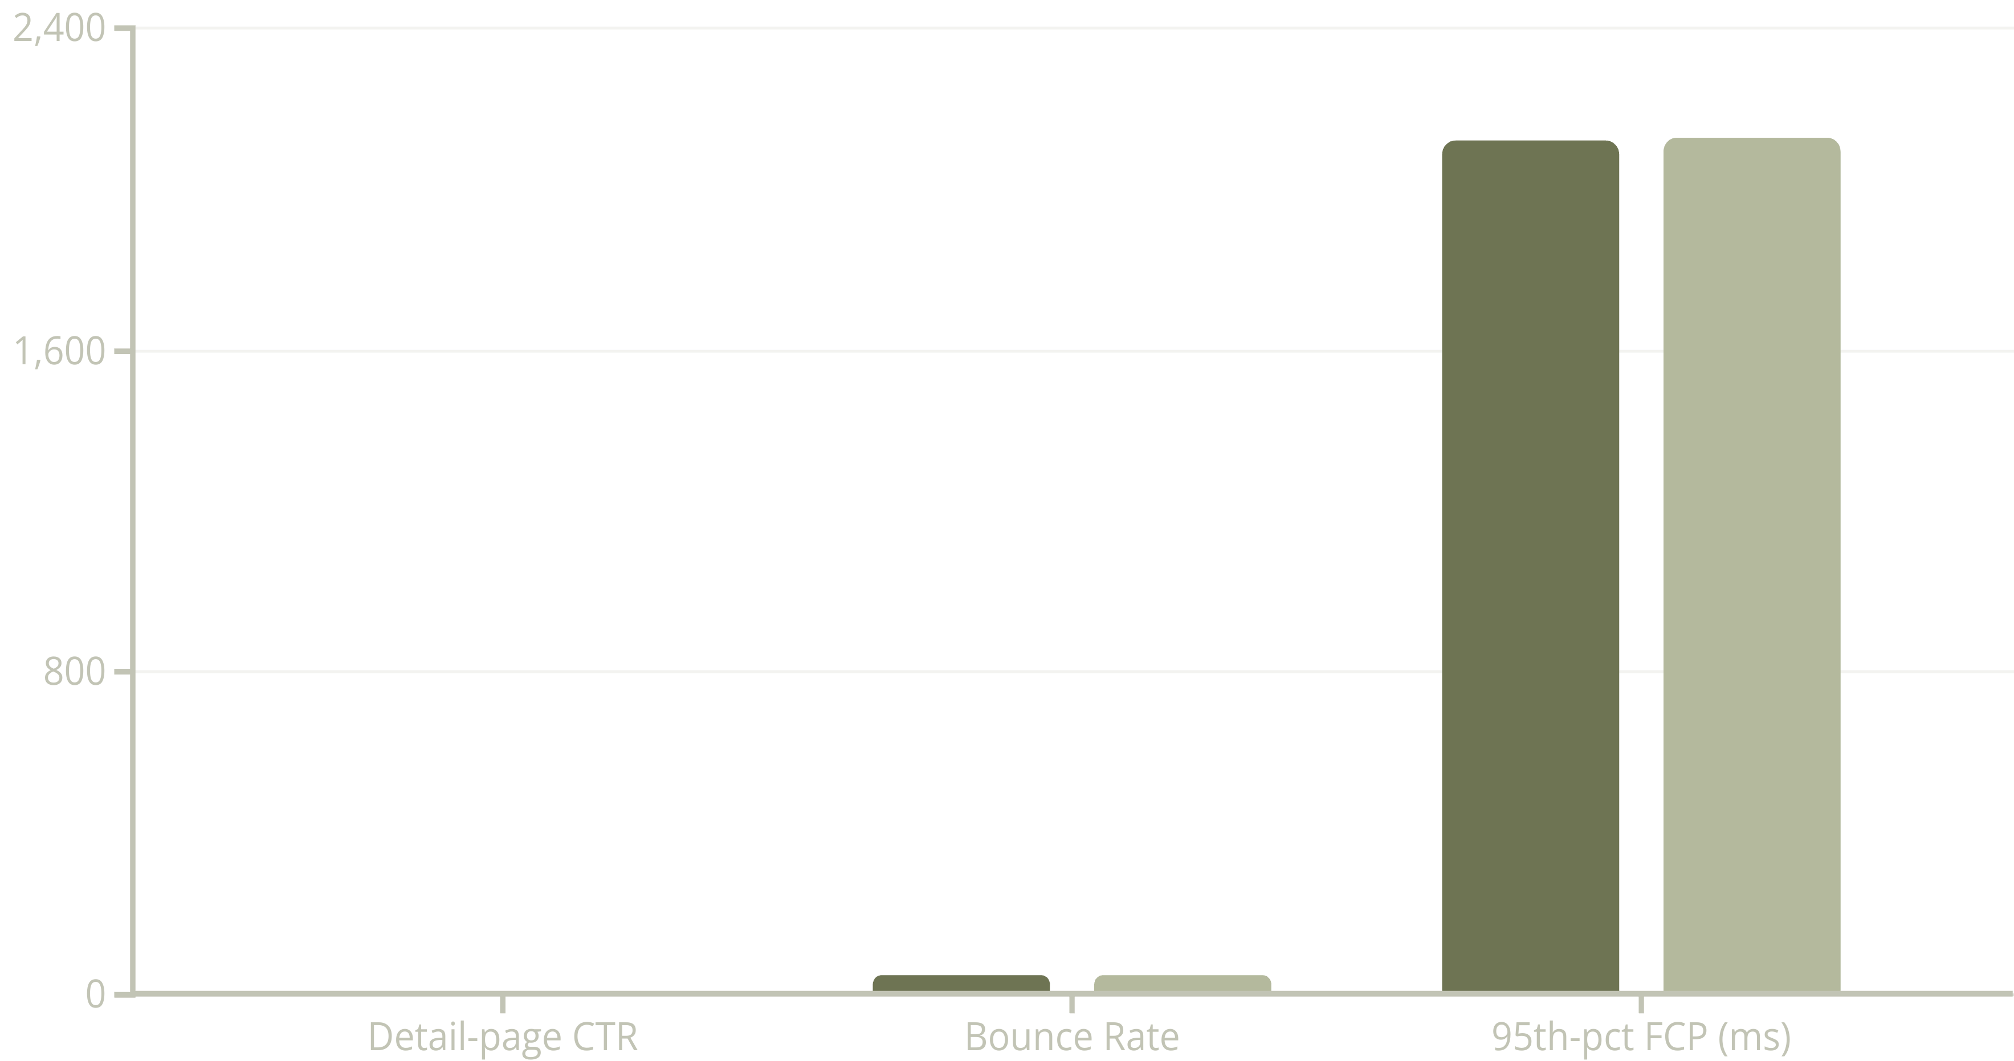
Test Results: Metrics Overview
Control
Treatment
Statistical analysis revealed the copy change produced a modest +1.1% lift in CTR (p=0.27), failing to reach statistical significance at our predetermined threshold.

Slide 8
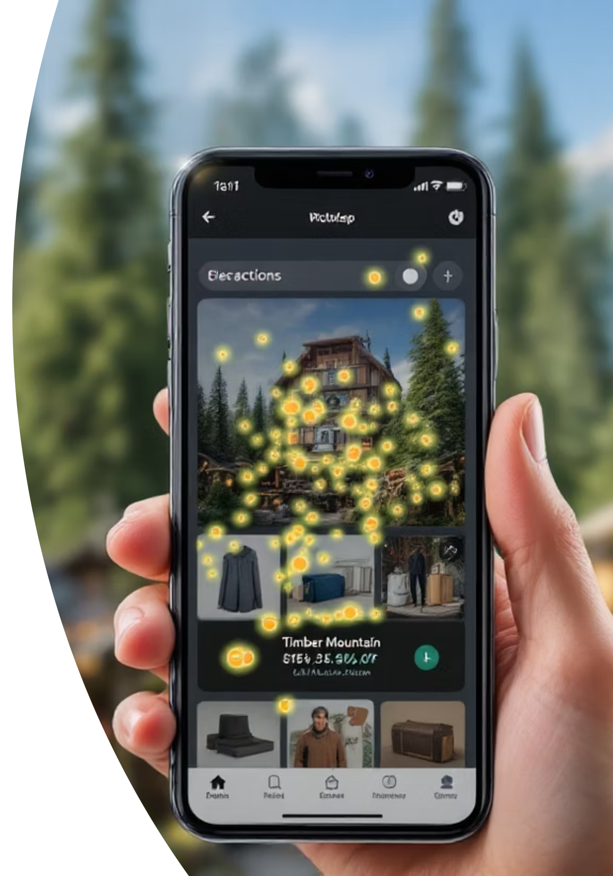



Qualitative Insights
Interaction Patterns
Scroll Behavior
Session-replay heatmaps revealed 71% of clicks clustered on hero images or carousel cards—with button text rarely being read before interaction.
Median users reached buttons in just 1.8 seconds; however, hero imagery appears first and absorbs most visual attention during this critical decision moment.
User Feedback
Exit poll comments frequently mentioned "I just tap the picture, not the button" - indicating users follow intuitive tapping behaviors rather than explicit button prompts.

Slide 9

Key Conclusions
The copy change alone did not achieve statistical significance (+1.1% lift, p = 0.27).
Evidence strongly suggests that CTA visibility and visual hierarchy, rather than verb choice, represents the more significant constraint on mobile engagement.
Most users appear to navigate intuitively by tapping images rather than searching for and reading button text.
The results challenge our initial assumption that copy changes alone would significantly influence behavior, pointing toward deeper UX patterns that merit further investigation.

Slide 10





Recommended Next Steps
Rethink Visual Prominence
Test larger, higher-contrast buttons or floating sticky CTAs that maintain visibility throughout the scrolling experience.
Combine Copy + Design
A/B test "Explore More" with supplementary iconography or directional arrows to enhance visual communication.
Image-Tap Instrumentation
Treat hero-image taps as intentional navigational clicks; evaluate routing logic to align with user expectations.
Multivariate Testing
Implement factorial design testing copy × color × placement to isolate the strongest drivers of engagement.

